Slide 1

Chapter 3
Arrays and Functions in PHP
Lecturer. Yahye Ali Isse
MSc of science in data science

Slide 2

Chapter Outlines
Introduction to Arrays
Numerically Indexed Arrays
The foreach...as Loop
Associative Arrays
Access mechanism operator (=>)
Multi-dimensional Arrays
Two-dimensional Numerical Indexed Array
Using Array Functions
Introduction to Functions
Parameters vs Arguments
Returning a Value
Passing By Value vs By Reference
Default Argument Value
Scope of Variables
Including Files in PHP

Slide 3
Introduction to Array
In PHP, an array is a variable that holds multiple values that are mapped to keys (indexes).
An array can hold many values under a single name, and you can access the values by referring to an index (a number or string).
Each member of the array is called an element. Some arrays are referenced by numeric indices; others allow alphanumeric identifiers.
Built-in functions let you sort them, add or remove sections, and walk through them to handle each item through a special kind of loop.
And by placing one or more arrays inside another, you can create arrays of two, three, or any number of dimensions.
One last feature of arrays in PHP is that you can actually assign different data types to the values within the array.
You can also use var_dump function to displays structured information about variables including its size, type and value.

Slide 4
Types of Arrays
In PHP, there are three types of arrays:
Numerically Indexed array − An array with a numeric index. Values are stored and accessed in linear fashion.
Associative array − An array with strings as index. This stores element values in association with key values rather than in a strict linear index order.
Multidimensional array − An array containing one or more arrays and values are accessed using multiple indices.

Slide 5
Numerically Indexed Arrays
Numerically indexed or numeric array stores each array element with a numeric index.
Array creation is pretty simple. First, you need to create a variable and then tell PHP that you want that variable to be an array:
$theVar = array();
Now, $theVar is an array. However, it’s an empty array waiting for you to come along and fill it.
In PHP, the array () function is used to create an array.

Slide 6
create an Numerically Indexed Arrays
There are two ways to create an arrays:
  The index can be assigned automatically (index always starts at 0), like this:
//exmaple of indexed array assigned automatically indexes
$fruits = array("Apple", "Orange", "Banana");
//displaying the array using echo function
echo $numbers[0]."<br>";
  Or the index can be assigned manually:
$fruits = array();
$fruits[0] = "Apple";
$fruits[1] = "Orange";
$fruits[2] = "Banana";

Slide 7
Numerically Indexed Arrays
  <?php
//Adding items to an array without explicit locations
$fruits[] = "Apple";
$fruits[] = "Orange";
$fruits[] = "Banana";
  ?>
//pre is a html tag that is used to display the array in a readable format
echo "<pre>";
//print_r is a shows the array structure
print_r($fruits);
  <pre> is commonly used with print_r() when you want to display an array or object clearly in a web browser.

Slide 8
Using Arrays Function (Display For Lop)
// this is an array that contains information about a person
$info = array (
"101",
"Mohamed Abdi Ali",
20,
"Hodan District",
"single"
);
// To loop through and print all the values of an indexed array, you could use a for loop
echo "Array values using for loop: <br>";
for ($i = 0; $i < count($info); $i++) {
echo $info[$i] . "<br>";}
Output:
Array elements are:
Array values using for loop:
  101
  Mohamed Abdi Ali
  20
  Hodan District
  single

Slide 9
The foreach...as Loop
You can use foreach…as statement to step through all the items in an array, one at a time, and do something with them.
The process starts with the first item and ends with the last one.
The foreach loop is a special version of the for loop that simplifies working with arrays. Here’s how it works:
    Use the foreach keyword to begin the loop.
    The first parameter is the array name.
    Create a variable (the scalar) after as keyword to hold each element of the array within the first parameter. On each pass through the loop, the variable will hold the current element of the array.
    Use the variable inside the loop to manipulate array elements.
  Example
$numbers = array (26, 11, 13);
echo "Array elements are: <br>";
foreach ($numbers as $n)
echo ("$n, ");
Output:
Array elements are: 26, 11, 13,

Slide 10
Adding array elements
$numbers = array (10, 10, 15);
$total = 0;
foreach ($numbers as $n)
$total += $n;
echo ("<br>Total of all elements is: $total");
Output: Total of all elements is: 35

Slide 11
Associative Arrays
In associative Arrays, you can reference the items in an array by name rather than by number.
Associative arrays are different than normal (numeric-indexed) arrays in some important ways:
  The order is undefined.
  You must specify a key (index).
  Associative arrays are best for name/value pairs.
  Some of PHP’s most important values are associative arrays. The $_REQUEST, $_GET, $_POST, $_FILES, etc., are an associative array.

Slide 12
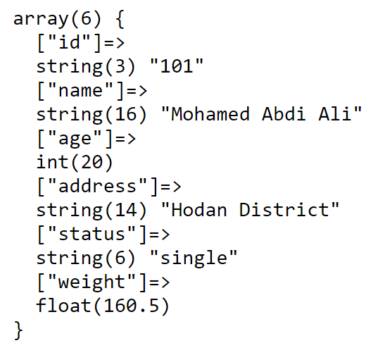
Associative Arrays
Use double arrow operator (=>) to connect key/value (index/value).
For example:
//example of associative array to store information about a person
$info = array (
"id"=>"101",
"name"=>"Mohamed Abdi Ali",
"age"=>20,
"address"=>"Hodan District",
"status"=>"single",
"weight"=> 160.5
);
//displaying the information stored in the associative array
echo "<pre>";
echo "Information about the person: <br>";
print_r($info);
var_dump($info);
echo "</pre>";

Slide 13
Associative Arrays
The names are called indexes or keys, and the items assigned to them are called values.
Adding items to an associative array and retrieving them
  <?php
  $info["id"] = "101";
  $info["name"] = "Mohamed Abdi Ali";
  $info["age"] = 20;
  $info["address"] = "Hodan District";
  $info["status"] = "single";
  $info["weight"] = 160.5;
  ?>

Slide 14
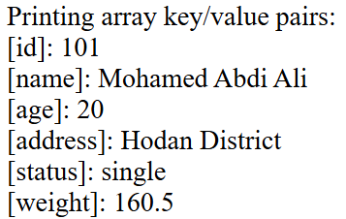
Associative Arrays
Note: Make sure to include quotation marks if you’re using a associative (string) as an array index. You can use single or double quotes in the indexes as well as values.
Printing array elements:
echo "Associative array elements are:<br>";
foreach ($info as $a)
echo ("$a<br>");
Use double arrow operator (=>) to access string index as well as the element.
echo ("Printing array key/value pairs:<br>");
foreach ($info as $k => $v)
echo ("[$k]: $v<br>");
Output:
Associative array elements are:
101, Mohamed Abdi Ali, 20, Hodan District, single, 160.5,

Slide 15
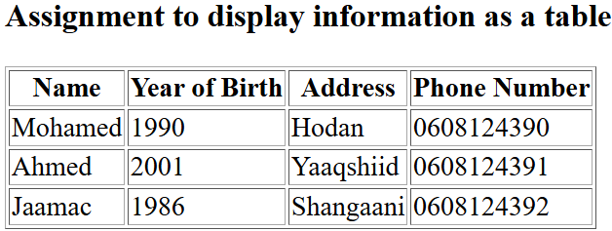
Multi-dimensional Arrays
Multidimensional array is the ability to include an entire array as a part of another one, and to be able to keep doing so.
A two-dimensional array is an array of array (a three-dimensional array is an array of array of array).
Multidimensional arrays are used when your data is arranged in some sort of tabular form.
Multidimensional arrays are set up in the same way as normal arrays. Note that the dimension of an array indicates the number of indices you need to select an element.
Two-dimensional Numerical Indexed Array
$student = array (
array ("Mohamed", 1990, "Hodan", "0608124390"),
array ("Ahmed", 2001, "Yaaqshiid", "0608124391"),
array ("Jaamac", 1986, "Shangaani", "0608124392"),
);
echo ("Printing array key/value pairs:<br>");
foreach ($student as $k)
echo ("$k[0], $k[1], $k[2], $k[3]<br>");
Or
echo "Array elements are:<br>";
foreach ($student as $s) {
foreach ($s as $v)
echo ("$v<br>");
}

Slide 16
Using Array Functions (1 of 5)
The array functions allow you to access and manipulate arrays. The array functions are part of the PHP core. There is no installation needed to use these functions. Sample of these functions are:
is_array: Checks whether a variable is an array.
in_array: Checks if a specified value exists in an array.
  if (in_array("Adhesives", $products))
  echo "<br>Match found";
count: Returns the number of elements in an array. sizeof function behaves like count.
sort: sorts an array in ascending order
rsort: sorts an array in descending order
asort: sorts an associative array in ascending order, according to the value.
arsort: sorts an associative array in descending order, according to the value.
max: Returns the highest value in an array.
min: Returns the lowest value in an array.
implode: function that takes an array and converts it to a string.

Slide 17
Example (is_array, in_array, count
$info = array (
"Mohamed",
"Ahmed",
"Jaamac",
21
);
//check if a variable is an array
if(is_array($info))
{
echo "Yes, it is an array";
}
else
{
echo "No, it is not an array";
}
//check if a specific value exists in an array
if(in_array("21", $info))
{
echo "<br>Mohamed exists in the array";
}
else
{
echo "<br>Mohamed does not exist in the array";
}
//check if specific key exists in an array using in_array
if(in_array("Ahmed", $student[1]))
{
echo "Yes, Ahmed exists in the array";
}
else
{
echo "No, Ahmed does not exist in the array";
}

Slide 18
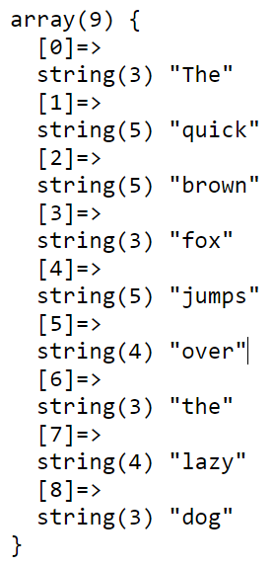
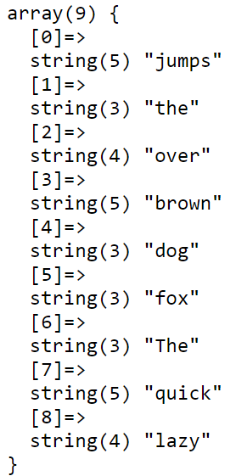
Explode , Shuffle function
explode: Place a string containing several words separated by a single character (e.g. space) into an array.
For example:
$a = "The quick brown fox jumps over the lazy dog";
$b = explode (" ", $a);
shuffle: Shuffles an array and put elements in random order.
shuffle($b);
echo "<pre>";
print_r($b);
echo "</pre>";
explode()
shuffle()

Slide 19
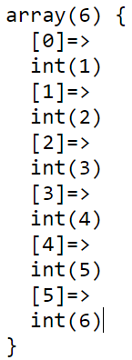
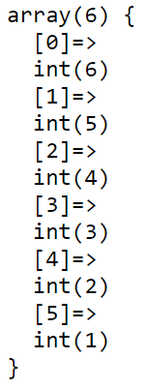
Array_Merge , Array_Reverse function
array_merge: Merges one or more arrays into one array.
$a1 = array (1, 2, 3,);
$a2 = array (1, 5, 6,);
$a3 = array_merge($a1,$a2);
echo "<pre>";
print_r($a3);
echo "</pre>";
array_reverse: Return an array in the reverse order.
$p =array_reverse($a3);
array_merge()
array_reverse()

Slide 20
array_push, array_pop, end function
array_push, array_pop, end function
array_push: adds elements to the end of the array and returns the new number of elements in the array.
  $a = array (2, 4, 6, 8);
  array_push($a, 10); // Output 5
array_pop: removes the last element of an array and returns the removed element.
  $a = array (1, 2, 3, 4);
  array_pop($a); // Output 4
  end: Sets the internal pointer of an array to its last element and returns its value.
$last=end($p);
echo "The last element of the array is: " . $last;

Slide 21
Introduction to function
A function is a set of statements that performs a particular task and, optionally, returns a value.
You can pull out a section of code that you have used more than once, place it into a function, and call the function by name when you want.
Functions can take values called arguments as input, perform some operations, and then may return another value.
The real power of PHP comes from its functions; it has more than 1000 built-in functions.

Slide 22
Introduction to function
The function transfers any argument values into new variables, called parameters, which can then be used within the function.
A function will be executed by a call to the function, just write its name and supply any arguments if there any.
A function will not execute automatically when a page loads.

Slide 23
Advantages
Functions have many advantages over inline code. For example, they:
  Involve less typing and less code.
  Reduce syntax and other programming errors.
  Decrease the loading time of program files.
  Decrease execution time, because each function is compiled only once, no matter how often you call it.
  Accept arguments and can therefore be used for general as well as specific cases.
  Code reusability because functions are defined only once and can be invoked many times.

Slide 24
Defining a Function
The general syntax for a function is as follows:
  function function_name([parameter [, ...]])
  {
  // Statements
  }
The first line of the syntax indicates the following:
  A definition starts with the word function.
  A name follows, which must start with a letter or underscore, followed by any number of letters, numbers, or underscores.

Slide 25
Defining a Function
  The parentheses are required.
  One or more parameters, separated by commas, are optional (as indicated by the square brackets).
Remember that function names are NOT case-sensitive in PHP.
Any parameter names are listed in parentheses after the function name.
The code that forms the body of the function is placed in braces { } after the parentheses.

Slide 26
Defining a Function
  The opening curly brace ({) starts the statements that will execute when you call the function; a matching curly brace (}) must close it.
  These statements may include return statement, which force the function to cease execution and return to the calling code. If a value is attached to the return statement, the calling code can retrieve it.

Slide 27
Example of function creating
function writeMsg ( ) {
echo "Hello world!";
}
To call the function, just write its name.
writeMsg ( ); // function call
You can call a function as many as you wish.

Slide 28
Example factorial of number
function factorial ($a) {
$result = 1;
for ($i = 1 ; $i <= $a; $i++)
$result *= $i;
echo "<br>Factorial of $a is : $result";
}
factorial (5);
Output: Factorial of 5 is : 120

Slide 29
Function Arguments
Information can be passed to functions through arguments. An argument is just like a value or variable.
Arguments are specified after the function name, inside the parentheses. You can add as many arguments as you want according to the parameters specified in the header of the functions, just separate them with a comma.
Differentiate between parameters and arguments .
  Arguments are values passed to a function.
  Parameters are the placeholders for arguments.
function factorial ($a) {
}
factorial (5);
Parameter
Argument

Slide 30
Returning a Value
When a function completes its task, it may return a value (variable)
To let a function return a value, use the return statement.
  return $result;
When calling a function that returns a value, you can assign the function result to a variable:
$a = factorial (5);
or use it as an argument when calling another function:
echo (factorial (5));

Slide 31
Example
function factorial ($a) {
$result = 1;
for ($i = 1; $i <= $a; $i++)
$result *= $i;
return ("<br>Factorial of $a is : $result");
}
echo (factorial (5));
Note: The return statement terminates the code execution at that point, so any code within a function after an executed return will never run.

Slide 32
Returning an Array
Returning an array from a function is a way of getting multiple values from a function.
$b = passingArray($array1);
echo ("<br>Returned array elements are: ");
foreach ($b as $v)
echo ("$v, ");
Output of the program:
Passed array elements are: 9, 2, 7, 5, 1, 6, 3, 8, 4,
Returned array elements are: 10, 3, 8, 6, 2, 7, 4, 9, 5,
$array1 = array (9, 2, 7, 5, 1, 6, 3, 8, 4);
function passingArray ($arr) {
echo ("<br>Passed array elements are: ");
for ($i = 0; $i < count($arr); $i++) {
echo ($arr[$i]. ", ");
$arr[$i]++;
}
return $arr;
}

Slide 33
Passing By Value
Passing arguments by value is passing a copy of the argument, not the original value. This method is the one we have already used in the previous examples.
No matter how we alter the value within the function, the value we have passed to it will remain the same.
This is the default process that you will use when passing variables to functions.

Slide 34
Passing By Reference
Involves the passed value being changed inside the function.
To indicate to PHP that you wish to use this method, you add an ampersand (&) to the front of the variable you are passing to (parameter).
Note that passing values by reference could be a security risk, and also a cause of tricky-to-track bugs. So, it is recommended not to use in PHP 5.4 and later versions.

Slide 35
By reference example
$a = 5;
function factorial (&$x){
echo ("<br>Factorial of $x = ");
$result = 1;
for ($i = 2; $i <= $x; $i++)
$result = $result * $i;
$x++;
echo ($result);
}
//Function calling:
factorial($a);
echo ("<br>Value of a = $a");
The output:
Factorial of 5 = 120
Value of a = 6

Slide 36
Default Argument Value
You can set default argument to a function, just supply the default value in the parameter.
For example: function factorial ($a = 5)
When you call the function, you omit the argument like factorial ( ); and it will take the default argument 5.

Slide 37
Scope of Variables
The scope of a variable is the part of the script where the variable can be referenced/used.
A variable declared within a function has a LOCAL SCOPE and can only be accessed within that function.
A variable declared outside a function has a GLOBAL SCOPE and can only be accessed outside a function.
You can have local variables with the same name in different functions, because local variables are only recognized by the function in which they are declared.

Slide 38
Global and Local Variables (cont…)
The lifetime of a variable is the span from the moment a variable is created to the moment it ceases to exist.
What happens if we have a local variable inside the function with the same name as a global variable outside the function?
We must have some way of identifying global variables inside the function. The global keyword is used to access a global variable from within a function.

Slide 39
Using global or GLOBALS
For example:
global $a;
echo $a; // Prints value of global variable
PHP also stores all global variables in an array called $GLOBALS[index]. The index holds the name of the variable. This array is also accessible from within functions and can be used to update global variables directly.
echo $GLOBALS["a"]; // Prints value of global variable
The global keyword is very simple to understand, but the $GLOBALS array is slightly less so.

Slide 40
Variable Scope - Superglobal variables
Several predefined variables provided by the PHP environment.
Global within the program, accessible absolutely everywhere.
Contain lots of useful information about the currently running program and its environment.
$_GET $_SESSION $_FILES $_SERVER $GLOBALS
$GLOBALS is a PHP super global variable which is used to access global variables from anywhere in the PHP script (also from within functions or methods).

Slide 41
Full example
$a = 5; //global variable
function factorial ($x) {
$a = 10; //local variable
echo ("<br>Factorial of $x = ");
$result = 1;
for ($i = 2; $i <= $x; $i++)
$result = $result * $i;
echo ($result);
//To print local variable:
echo ("<br>Value of local a = $a");
//To print global variable:
echo ("<br>Value of global a = ". $GLOBALS["a"]);
}
factorial($a); // $a = 5
Factorial of 5 = 120
Value of local a = 10
Value of global a = 5

Slide 42
Recap of Variable Scope
Local variables are accessible just from the part of code where you define them.
Global variables are accessible from all parts of your code.
Static variables are accessible only within the function that declared them but retain their value over multiple calls.
Generally, try to make as many of your variables local as possible. The only time you really need a global variable is when you want some information to be used in multiple functions.

Slide 43
Including Files in PHP
It is possible to insert the content of one file (html or php) into another PHP file (before the server executes it), with the include or require statement.
As you progress in your use of PHP programming, you are likely to start building a library of functions that you think you will need again. You will also probably start using libraries created by other programmers.
There is no need to copy and paste these functions into your code. You can save them in separate files and use commands to pull them in. There are two types of commands to perform this action: include and require.

Slide 44
The include Statement
Using include, you can tell PHP to fetch a particular file and load all its contents. It is as if you pasted the included file into the current file at the insertion point.
The following example shows how you would include a file called library.php.
<?php
  include "library.php";
  // Your code goes here
?>

Slide 45
The include Statement (cont…)
You can use include files to include text, HTML code, or PHP script.
Including files saves a lot of work. This means that you can create a standard header, footer, or menu file for all your web pages. Then, when the header needs to be updated, you can only update the header file.

Slide 46
Using include_once
The include_once ( ) statement includes and evaluates the specified file during the execution of the script. This is a behavior similar to the include ( ) statement and as the name suggests, it will be included just once.
<?php
  include_once "library.php";
  // Your code goes here
?>

Slide 47
Using require and require_once
A potential problem with include and include_once is that PHP will only attempt to include the requested file. Program execution continues even if the file is not found.
When it is absolutely essential to include a file, use require statement. For the same reasons of using include_once, it is recommended that you generally stick with require_once whenever you need to require a file.

Slide 48
include vs require
The include and require statements are identical, except upon failure:
  require will produce a fatal error (E_COMPILE_ERROR) and stop the script
  include will only produce a warning (E_WARNING) and the script will continue

Slide 49
Check for function existence
If you need to check whether a particular function is available to your code, you can use the function_exists function, which checks all predefined and user-created functions.
For example:
  if (function_exists("factorial"))
  echo ("<br>This function exists");

Slide 50
Understanding Paths
There are a few things that all developers should consider when including files. If you develop your website on your local machine and you define the full path of the included files, you may run into problems on the live server if your paths are different.
For example:
require_once ("../abc/include.php");
../ is a relative path to a file in a directory starting from the current directory.

Slide 51
END!!

